Slide 1
Model 2 Introduction to Cryptography
Lesson 1: Cryptography Overview

Slide 2
Module 2: Introduction to Cryptography
Module Description:
This module provides an overview of cryptography. Students will be given an overview at first, such as different encryption methods. Then more details will be provided on symmetric cryptography and asymmetric cryptography, such as DES, AES, RSA. Another micro module talks about cryptographic applications that are widely used in the real world.
Topics:
Lesson 1: Cryptography Overview
Lesson 2: Symmetric and Asymmetric Cryptography
Lesson 3: Cryptographic Applications

Slide 3
Lesson 1: Cryptography Overview
Topics:
Basic concepts of cryptography (encryption, decryption, plaintext, ciphertext, key)
Different methods of encryption (substitution, Transposition, diffusion, permutation, symmetric encryption, asymmetric encryption, block encryption, stream encryption)
Learning Outcomes:
Upon completion of this lesson:
Students will be able to list the elements of a cryptographic system.

Slide 4
Warm up
Where do we need encryption?
Do you use encryption? How?

Slide 5
Terminology (1)
Cryptographic system - Associated information assurance items interacting to provide a single means of encryption or decryption.
Plaintext - Data input to the Cipher or output from the Inverse Cipher.
Ciphertext - Data output from the Cipher or input to the Inverse Cipher.
Cipher - Any cryptographic system in which arbitrary symbols or groups of symbols, represent units of plain text, or in which units of plaintext are rearranged, or both.

Slide 6
Terminology (2)
Encryption (encode, encipher) - Conversion of plaintext to ciphertext through the use of a cryptographic algorithm.
Decryption (decode, decipher) - Conversion of ciphertext to plaintext through the use of a cryptographic algorithm.
Cryptography - The discipline that embodies the principles, means, and methods for the transformation of data in order to hide their semantic content, prevent their unauthorized use, or prevent their undetected modification.
Cryptology - The science that deals with hidden, disguised, or encrypted communications. It includes communications security and communications intelligence.

Slide 7
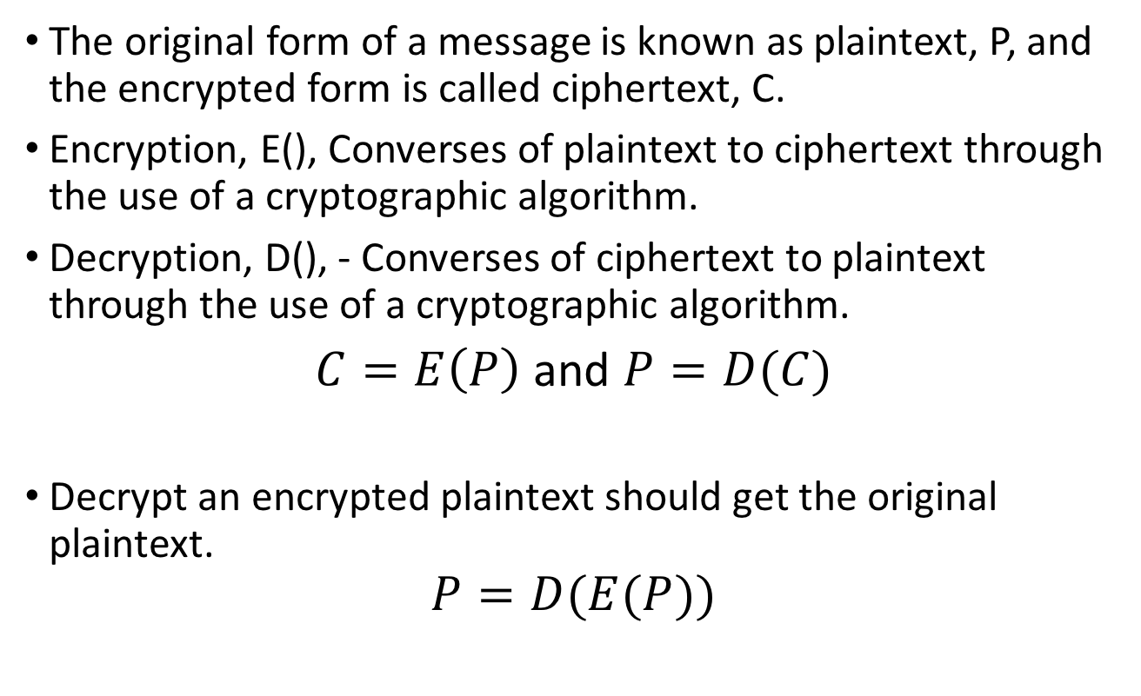
Encryption Notations
The original form of a message is known as plaintext, P, and the encrypted form is called ciphertext, C.
Encryption, E(), Converses of plaintext to ciphertext through the use of a cryptographic algorithm.
Decryption, D(), - Converses of ciphertext to plaintext through the use of a cryptographic algorithm.
$C=E\left(P\right)$ and $P=D(C)$
Decrypt an encrypted plaintext should get the original plaintext.
$$P=D(E(P))$$

Slide 8
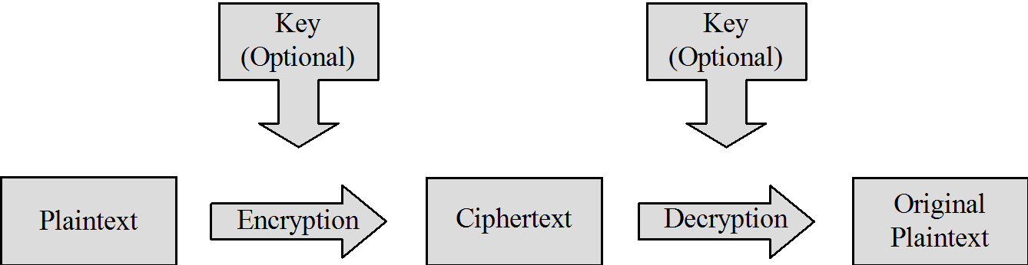
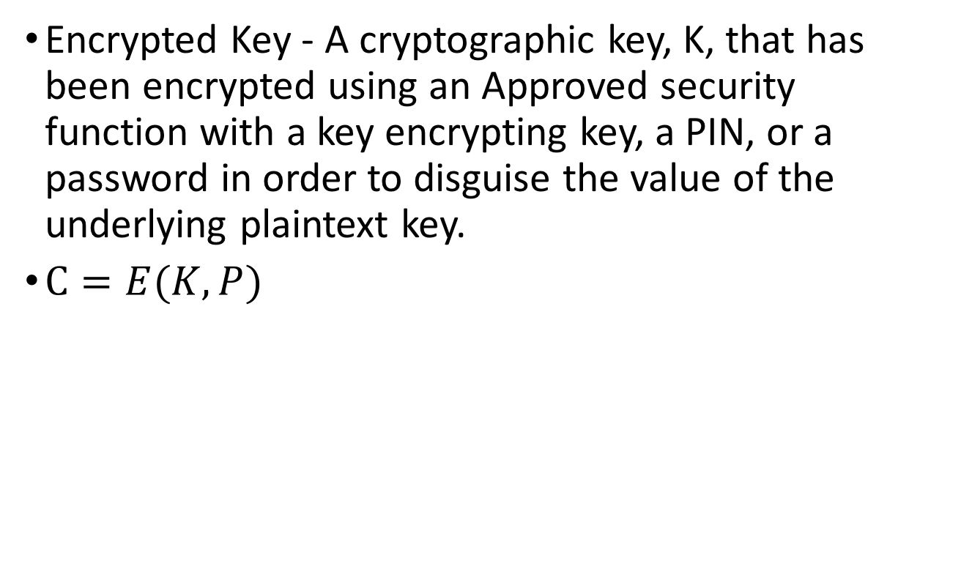
Encryption keys
Encrypted Key - A cryptographic key, K, that has been encrypted using an Approved security function with a key encrypting key, a PIN, or a password in order to disguise the value of the underlying plaintext key.
$C=E(K,P)$

Slide 9
Cryptography Classification
By number of keys
Symmetric (Secret key cryptography)
Asymmetric (Public key cryptography)
By encryption operations
Substitution
Transposition
By how plaintext is processed
Block encryption
Stream encryption

Slide 10
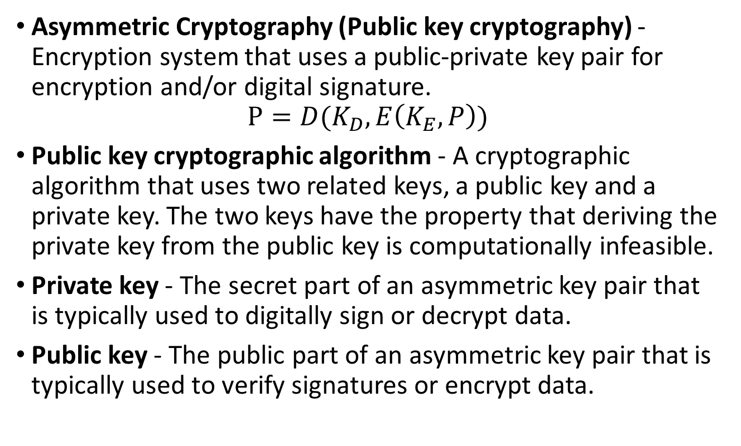
Asymmetric encryption (a pair of keys)
Asymmetric Cryptography (Public key cryptography) - Encryption system that uses a public-private key pair for encryption and/or digital signature.
$$P=D(K_{D},E\left(K_{E},P\right))$$
Public key cryptographic algorithm - A cryptographic algorithm that uses two related keys, a public key and a private key. The two keys have the property that deriving the private key from the public key is computationally infeasible.
Private key - The secret part of an asymmetric key pair that is typically used to digitally sign or decrypt data.
Public key - The public part of an asymmetric key pair that is typically used to verify signatures or encrypt data.

Slide 11
Block cipher
Block cipher - A symmetric key cryptographic algorithm that transforms a block of information at a time using a cryptographic key.
For a block cipher algorithm, the length of the input block is the same as the length of the output block.
One block of elements will be processed at a time, an output block will be generated for each input block.

Slide 12
Stream Cipher
Stream cipher, each bit or each byte of the data stream is encrypted separately.
It processes the input elements continuously, producing output one element at a time.

Slide 13
Stream cipher vs. Block cipher
 | Advantages | Disadvantages
Block cipher | High diffusion Insertions have low impact | Slower than stream cipher Padding needed High error propagation
Stream cipher | Fast Low error propagation | Low diffusion Susceptibility to insertions

Slide 14
Transposition Cipher
Transposition cipher: Rearrange letters in plaintext to produce ciphertext.
Example (Rail fence cipher):
Plaintext is HELLO WORLD
Rearrange as
HLOOL
ELWRD
Ciphertext is HLOOL ELWRD
Letters stay the same, but the order is all mixed up.

Slide 15
Transposition Cipher (cont.)
Example:
Plaintext: troops heading east need more supplies. send more people to help
Ciphertext: tidie ernme plogo sepoe rsopa eepss snlht udeen pmtae poode lrh
t | r | o | o | p | s | h | e | a | d
i | n | g | e | a | s | t | n | e | e
d | m | o | r | e | s | u | p | p | l
i | e | s | s | e | n | d | m | o | r
e | p | e | o | p | l | e | t | o | h
e | l | p

Slide 16
Row Transposition Cipher
Row Transposition Ciphers: Write letters in rows, reorder the columns according to the key before reading off.
Key: 4312567
Column Out 4 3 1 2 5 6 7
a t t a c k p
o s t p o n e
d u n t i l t
w o a m x y z
Ciphertext: TTNAAPTMTSUOAODWCOIXKNLYPETZ

Slide 17
Substitution Cipher
Change characters in plaintext to produce ciphertext
First recorded use of Substitution Cipher is Ceasar cipher.
Plaintext is HELLO WORLD
Change each letter to the third letter following it (A to D, X to A, Y to B, Z to C)
Key is 3, usually written as letter ‘D’
Ciphertext is KHOOR ZRUOG

Slide 18

Ceaser Cipher
Encode
Key is 3 (A -> D, L -> O, X -> A, Z -> C)
$Ci=E\left(pi\right)=\left(pi+3\right) mod 26$
Y + 3 = B (24 + 3) mod 26 = 1
LETTER | A | B | C | D | E | F | G | H | I
CODE | 0 | 1 | 2 | 3 | 4 | 5 | 6 | 7 | 8
LETTER | J | K | L | M | N | O | P | Q | R
CODE | 9 | 10 | 11 | 12 | 13 | 14 | 15 | 16 | 17
LETTER | S | T | U | V | W | X | Y | Z
CODE | 18 | 19 | 20 | 21 | 22 | 23 | 24 | 25

Slide 19
Exercise 2
Ciphertext:
LEWLJAPUN ADV OVTLDVYR HZZPNUTLUAZ AOPZ DLLR
Hint: Character Frequency
LETTER | A | B | C | D | E | F | G | H | I
CODE | 0 | 1 | 2 | 3 | 4 | 5 | 6 | 7 | 8
LETTER | J | K | L | M | N | O | P | Q | R
CODE | 9 | 10 | 11 | 12 | 13 | 14 | 15 | 16 | 17
LETTER | S | T | U | V | W | X | Y | Z
CODE | 18 | 19 | 20 | 21 | 22 | 23 | 24 | 25

Slide 20
Exercise 2 Answer
Ciphertext:
LEWLJAPUN ADV OVTLDVYR HZZPNUTLUAZ AOPZ DLLR
Plaintext:
Expecting two homework assignments this week
Key is 7

Slide 21
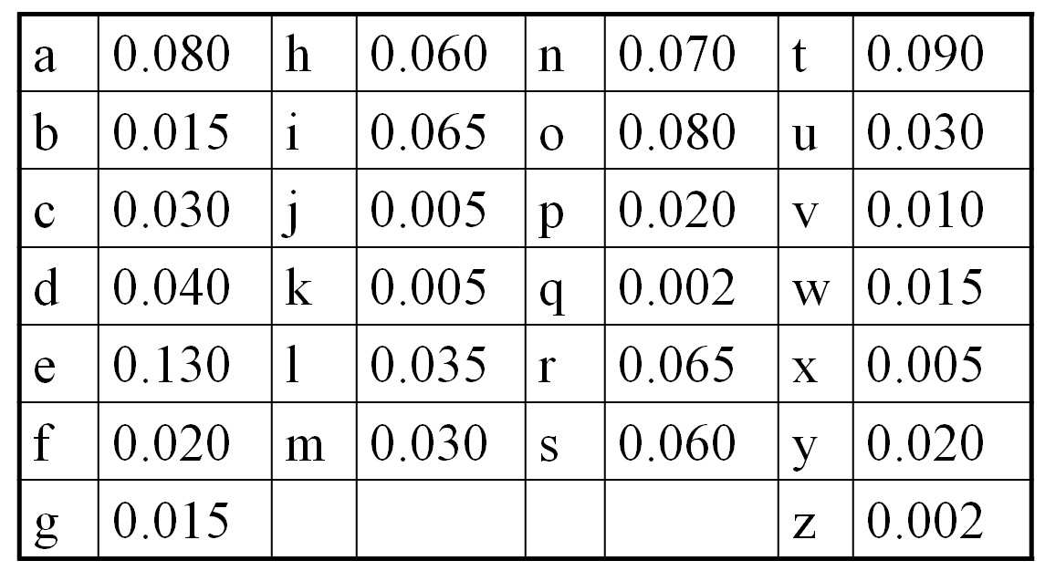
Statistical Analysis
Text in any natural language has patterns.
Character frequencies
Certain letter pairs: EN, RE, ER, and NT
Certain letter triples: ION, AND, and ING
TOP 9:
E 0.130
T 0.090
A 0.080
O 0.080
N 0.070
I 0.065
R 0.065
H 0.060
S 0.060

Slide 22
Vigènere Cipher
Like Ceasar cipher, but use a phrase
Example
Plaintext: THE BOY HAS THE BALL
Key: VIG
Encipher using Ceasar cipher for each letter:
key V IGV IGV IGV IGV IGV
plain THEBOYHASTHEBALL
cipher OPKWWECIYOPKWIRG
A | B | C | D | E | F | G | H | I
0 | 1 | 2 | 3 | 4 | 5 | 6 | 7 | 8
J | K | L | M | N | O | P | Q | R
9 | 10 | 11 | 12 | 13 | 14 | 15 | 16 | 17
S | T | U | V | W | X | Y | Z
18 | 19 | 20 | 21 | 22 | 23 | 24 | 25

Slide 23
Exercise 3
Ciphertext:
I I P Q I F Y S T Q W W B T N U I U R E U F
Key is MEC
A | B | C | D | E | F | G | H | I
0 | 1 | 2 | 3 | 4 | 5 | 6 | 7 | 8
J | K | L | M | N | O | P | Q | R
9 | 10 | 11 | 12 | 13 | 14 | 15 | 16 | 17
S | T | U | V | W | X | Y | Z
18 | 19 | 20 | 21 | 22 | 23 | 24 | 25

Slide 24
Exercise 3 Answer
Ciphertext:
I I P Q I F Y S T Q W W B T N U I U R E U F
Key is MEC
W E N E E D M O R E S U P P L I E S F A S T
I (8) – M (12) = W (22)
I (8) – E (4) = E (4)
P (15) – C (2) = N (13)
A | B | C | D | E | F | G | H | I
0 | 1 | 2 | 3 | 4 | 5 | 6 | 7 | 8
J | K | L | M | N | O | P | Q | R
9 | 10 | 11 | 12 | 13 | 14 | 15 | 16 | 17
S | T | U | V | W | X | Y | Z
18 | 19 | 20 | 21 | 22 | 23 | 24 | 25

Slide 25
Confusion vs Diffusion
Confusion: An encryption operation where the relationship between the key and ciphertext is obscured.
by doing substitution
each letter can be mapped to any other letters
Diffusion: An encryption operation where the influence of one plaintext bit is spread over many ciphertext bits.
hiding statistical properties of the plaintext
a letter is not just mapped to another letter in the English alphabet
by doing permutation

Slide 26
Attacks on Encryption
Brute-force attack
Try all possible keys
Implementation attacks
Exploit implementation or systems issues
Cryptanalysis
Analysis the algorithm and characteristics of the data
Social-engineering attacks

Slide 27
Summary
Topics:
Basic concepts of cryptography (encryption, decryption, plaintext, ciphertext, key)
Different methods of encryption (substitution, Transposition, diffusion, permutation, symmetric encryption, asymmetric encryption, block encryption, stream encryption)

Slide 28
Please attribute Dr. Jim Alves-Foss and Dr. Jia Song, University of Idaho
Except where otherwise noted, this work is licensed under https://creativecommons.org/licenses/by-nc-sa/4.0/ Not withstanding the non-commercial license terms, non-profit educational institutions are granted a non-exclusive license to adapt and use this material, with attribution. Creative Commons and the double C in a circle are registered trademarks of Creative commons in the United States and other countries. Third party marks and brands are the property of their respective holders.
Project sponsored by the National Security Agency under grant Number H98230-17-1-0199. The United States Government is authorized to reproduce and distribute reprints notwithstanding any copyright notation herein.

